Slide 1


Energy Village
Novia University of Applied Sciences
Interim report presentation
Make a plan to provide Komossa of green energy and make it self-sufficient
Rudy Chambon
Kristian Granqvist
Xavier Agusti Sanchez
Miguel Angel Huerta Arocas
Vincent Fulcheri
Content:
Results of our research of all the different energy potential usable in Komossa.
Wednesday, October 31st 2012

Slide 2
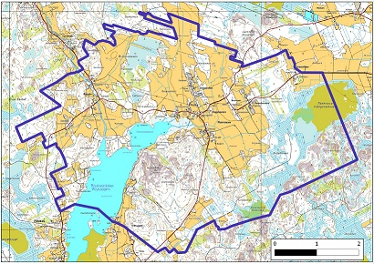
Data of Komossa
Rudy Kristian Xavier Miguel Vincent
Finland – Ostrobothia – Municipality of Vörå
120 people in 45 houses => 2.7 p/house
6 different types of buildings
28 km² => 4.3 p/km²
Electricity company: Herrfors
Total energy use: 1286 MWh in one year => appr. €200.000
Interested in:
  Wind power
  Biofuel
  Existing woodchip burning plants
  Central heating system
  Use of Hill Hoppamäki
  The lakes environment
Energy village Special meeting 31/10/12

Slide 3
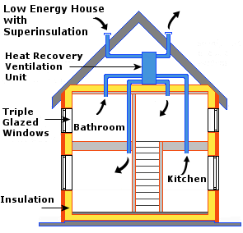
Insulation
Rudy Kristian Xavier Miguel Vincent
Short payback time
Save a lot of money
Live healthier
Help the environment
Passive house
  No warmth or cold gets lost through the insulation
  No energy needed to maintain a suitable temperature
  10 times more energy efficient than normal (existing) houses
Energy village Special meeting 31/10/12

Slide 4
Window Insulation
Rudy Kristian Xavier Miguel Vincent
Normal house has around 20 m² of windows
Savings
Savings are ≈ €45 per m² per year
This would be ≈ €905 per house per year
Investments
One m² = €109.25
20 m² = €2185.00
Payback time is 2 years and 5 months
Energy village Special meeting 31/10/12

Slide 5
Floor Insulation
Rudy Kristian Xavier Miguel Vincent
An average floor surface of 121 m²
Savings
Savings are ≈ €7.5 per m² per year
This would be ≈ €912 per house per year
Investments
One m² = €25
20 m² = €3025.00
Payback time is 3 years and 4 months
Energy village Special meeting 31/10/12

Slide 6
Cavity Wall Insulation
Rudy Kristian Xavier Miguel Vincent
An average wall surface of 145 m²
Savings
Savings are ≈ €13.5 per m² per year
This would be ≈ €1967 per house per year
Investments
One m² = €19
20 m² = €2755.00
Payback time is 1 years and 5 months
Energy village Special meeting 31/10/12

Slide 7
Ceiling Insulation
Rudy Kristian Xavier Miguel Vincent
An average ceiling surface of 156 m²
Savings
Savings are ≈ €11.7 per m² per year
This would be ≈ €1828 per house per year
Investments
One m² = €20
20 m² = €3120.00
Payback time is 1 years and 8 months
Energy village Special meeting 31/10/12

Slide 8
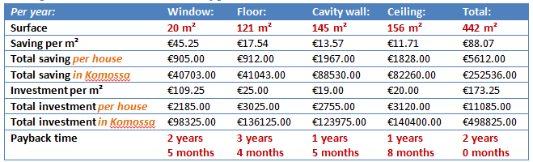
Insulation (overview)
Rudy Kristian Xavier Miguel Vincent
Energy village Special meeting 31/10/12

Slide 9
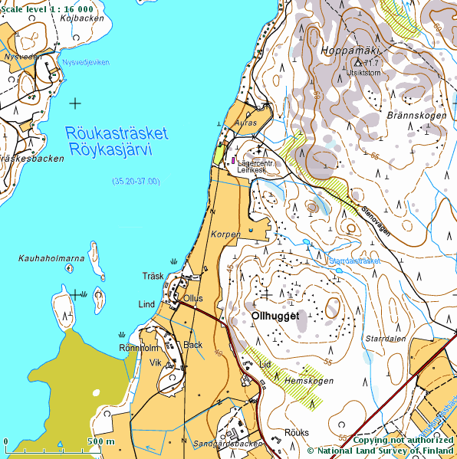
Why Wind Power ?
Rudy Kristian Xavier Miguel Vincent
On the area is one of the highest points in Ostrobottnia region , Hoppamäki , 72 meters above sea level.
Wind energy potential is high.
Komossa is interested in Windpower production.
All the conditions are present to take an interest to this type of energy.
Energy village Special meeting 31/10/12

Slide 10
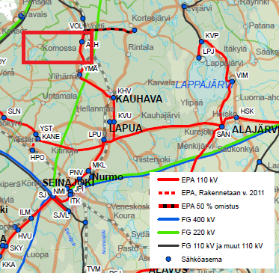
Connexion to Electrical network ?
Rudy Kristian Xavier Miguel Vincent
The wind turbines are generally connect to an electrical grid 110 kV.
Here, we can see that there is a electric network of 110 kV . But , I don't know the distance who exist between Hoppamäki of this electrical grid.
This distance is important because the cost of connection to the network is very expensive and can change considerably the cost of the project.
Energy village Special meeting 31/10/12

Slide 11

Which type of Wind power to choose?
Rudy Kristian Xavier Miguel Vincent
We have taken into account 3 types of wind power :
  The traditional wind turbines
  The small wind turbines
  The hybrid systems : Solar-Wind & Water-Wind
After a technical and economic study, it seems that Komossa is more likely chooses for a traditional wind turbine.
Explanations :
For the small wind turbines, the price by Kw is bigger than traditional Wind turbine.
Wind / Solar: Not a good hybrid system here (Energies not controllable).
Wind / Hydraulic: Better, because it’s very simple to produce hydraulic energy quickly.
That is to say, when the wind is too low and doesn't produce enough electricity.
The hydropower can fill this gap because his electrical production is instantly.
But, this solution is more expensive.
Energy village Special meeting 31/10/12

Slide 12

Economic aspects
Rudy Kristian Xavier Miguel Vincent
Investment cost
  It’s €1.23 million/MW of rated power installed.
  This investment cost can vary between €1000/kW to €1350/kW.
  This price includes:
    turbine,
    civil engineering (foundations ..),
    electrical installation ( grid connection),
    transportation,
    lifting the turbine,
    Etc.
Energy village Special meeting 31/10/12

Slide 13

Economic aspects
Rudy Kristian Xavier Miguel Vincent
Operation and Maintenance Costs
  It’s 1.2 to 1.5 c/kWh of wind power produced, over the total lifetime of a turbine.
  This price includes:
    Insurance
    Regular maintenance
    Repair
    Spare parts
    Administration work
Energy village Special meeting 31/10/12

Slide 14
Economic aspects
Rudy Kristian Xavier Miguel Vincent
The Cost of Energy Generated by Wind Power
  The costs range from :
    7-10 c€/kWh at sites with low average wind speeds,
    5-6.5 c€/kWh at coastal sites,
    7 c€/kWh at a wind site with middle wind speeds.
Subsidies
    A fixed subsidy is available for Wind power plants:
    Target price for wind power is 83.50 €/MWh
    Period: Feed-in tariff is paid for 12 years,
    Producer is paid a feed-in tariff, which is the difference between the target price and the average electricity market spot price
    For Example: If the spot price is €50, feed-in tariff is 33.50 €/MWh (€83.50 – €50)
Energy village Special meeting 31/10/12

Slide 15

Economic aspects
Rudy Kristian Xavier Miguel Vincent
Payback Time
  Generally between 8 – 11 years, if you exceed 12 years, you have to change the place of your Wind turbine and find another area where the Wind speed is better.
  For example: For a wind turbine rated power of 1 MW, the investment price is close to 1,225 M €. The payback is done when the total income of all sold electricity surpasses the investment plus the maintenance cosT.
Energy village Special meeting 31/10/12

Slide 16
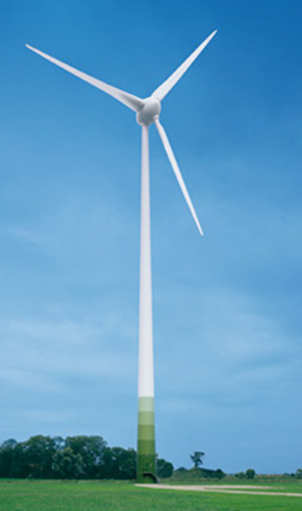
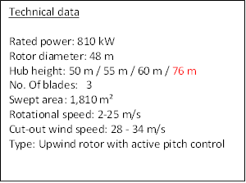
Conclusion / Estimation cost
Rudy Kristian Xavier Miguel Vincent
Wind turbine
Manufacturer : Enercon
Type : E-48
Time life estimation : 20 years
Energy village Special meeting 31/10/12

Slide 17
Conclusion / Estimation cost
Rudy Kristian Xavier Miguel Vincent
Estimation
Enercon E-48 | Single cost | Komossa
Investment cost | € 1,230 Million/ MW | € 996 000
Maintenance | 1,35 c€/ KWh | € 405 000
Total expense |  | € 1400 000
Subsidies | € 40/ MWh | € 62 800/ Years
Cost generated by WP | 8 c€/KWh | € 125 600/ Years
Total gain |  | € 188 000/ Years
Payback | ± 7,5 years
Energy village Special meeting 31/10/12

Slide 18
Solar Energy
Rudy Kristian Xavier Miguel Vincent
Electricity with Photovoltaic Solar Panels
The current legislation in Finland prevents small solar power installations can be connected to the general electricity network, being so, an isolated network for self-consumption network.
For this reason, all the energy produced by the solar electric, must be consumed instantly or stored in batteries.
In Finland the production of solar energy is subject of daylight hours it has each month. Just as in summer the production is very high thanks to the high number of hours of sunshine, in winter, however, the production is minimal because of the few hours of sun and the sky is covered.
Energy village Special meeting 31/10/12

Slide 19
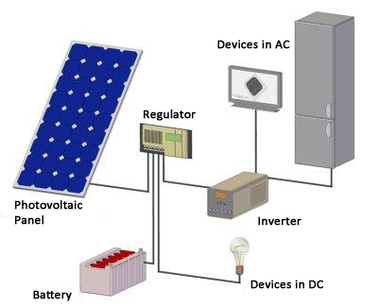
Solar Energy
Rudy Kristian Xavier Miguel Vincent
Operating Scheme
Components
Photovotaic panels: Transform the photons sent by the sun in electric current.
Regulator: Controls the passing of electric current to the inverter and regulates the charging and discharging of the batteries to prevent damage.
Inverter: Responsible for increase the tension and changes the DC to AC, to run the domestic devices.
Batteries: Electricity overproduction is stored, avoid power failure the days of little sun. Give autonomy to the installation.
Energy village Special meeting 31/10/12

Slide 20
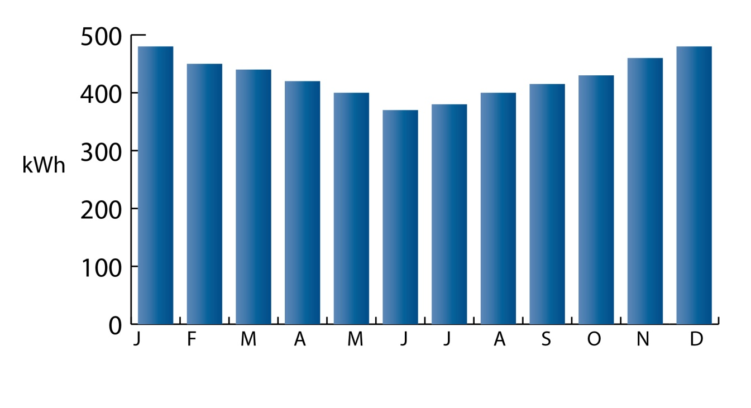
Solar Energy
Rudy Kristian Xavier Miguel Vincent
The study has been performed for sizing a PV installation is based on a detached house formed by 4 people with an average consumption of 5000 kWh per year.
The chart shows the average consumption of electricity per month a long a year, the maximum consumption stands at 490 kWh in January, and a minimum of 360 kWh in June.
Energy village Special meeting 31/10/12

Slide 21
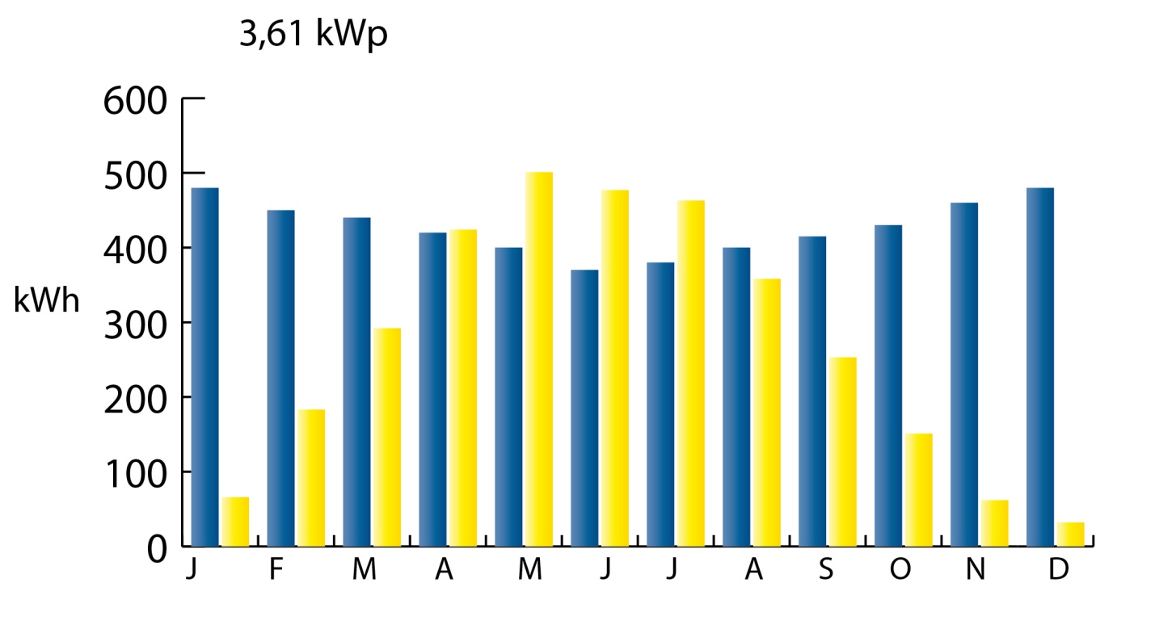
Solar Energy
Rudy Kristian Xavier Miguel Vincent
After making a dimensioning of the installation, it is concluded that the consumption during the summer months is covered with solar energy production and have some days of itself autonomy, is considered a power of about 3.61 kWp installation.
The chart shows the monthly production of electricity, compared to consumption per month.
Energy village Special meeting 31/10/12

Slide 22
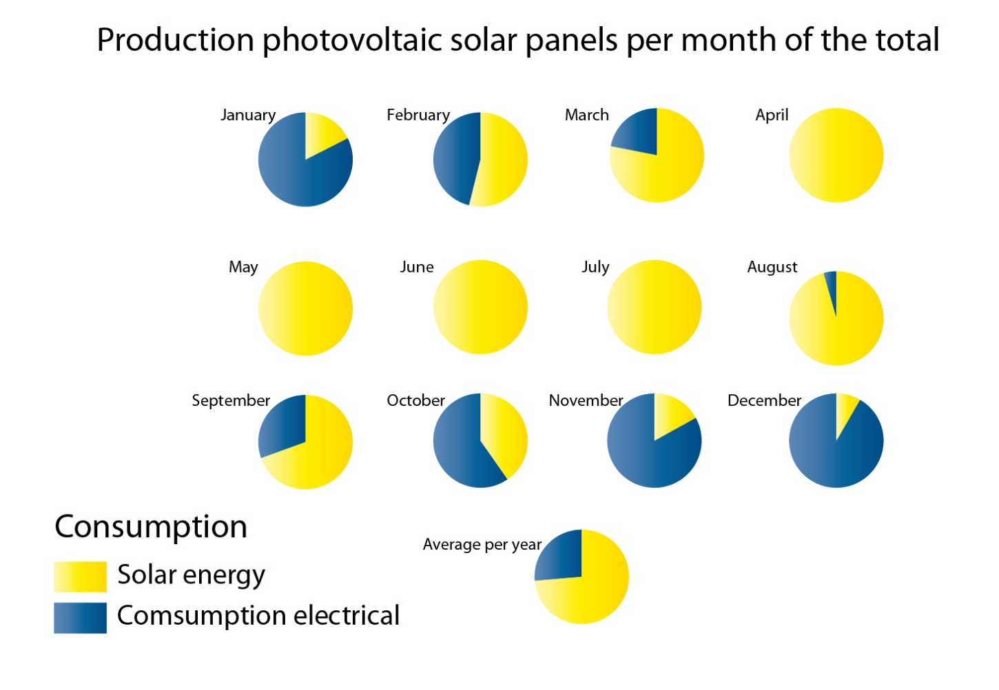
Solar Energy
Rudy Kristian Xavier Miguel Vincent
This graph shows the percentage of solar energy covers the total consumption by month, shows that 5 months of the year the installation is sufficient, but the other 7 months of the year is needed additional energy to supply the consumption.
Energy village Special meeting 31/10/12

Slide 23
Solar Energy
Rudy Kristian Xavier Miguel Vincent
Installation Elements | Type | Price Unit € | Required Quantity | Price Total €
Inverter | Inversor Senoidal Solener ISC 5000 24 | 1640 | 1 | 1640
Batteries | 20 OPzS 2.500 3720 Ah | 6100 | 1 | 6100
Solar Panels | 195D-24(S) 195W | 250 | 19 | 4750
Regulator | SS – 60 C 60A | 280 | 2 | 560
 |  |  | Total | 13,050 €
The budget for an installation of this size is between 14,000 and 15,000 €. Depending on the company to install and the chosen components. The time to recover the investment, or payback time is about 21 years, taking into account that the useful life of the installation is between 24 and 28 years. The investment can be somewhat risky. Also in the winter months and autumn consumption is not covered.
Preparation roof | 100 €
Wiring and Protection Devices | 400 €
Installation and assembly | 650 €
Licensing and Administrative Procedures | 200 €
Total | 1300 €
13,050 + 1300 = 14,350 € ≈ 14000 – 15000 €
Energy village Special meeting 31/10/12

Slide 24


Rudy Kristian Xavier Miguel Vincent
Energy village Special meeting 31/10/12

Slide 25

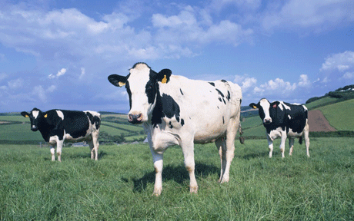
BIOGAS
Rudy Kristian Xavier Miguel Vincent
RESOURCES IN KOMOSSA AND POTENTIAL ENERGY
Crops
  The main crop growing in Komossa is barley with 80% of the whole harvest
  Total barley available = 388 ha
  Total biogas production by barley ~ 690,000 m3
Manure
  Manure from cattle and pig of around 2500 animals
  Total biogas from manure ~ 190,000 m3
BIOGAS PRODUCTION
The biogas potential ~ 880,000 m3
Energy village Special meeting 31/10/12

Slide 26
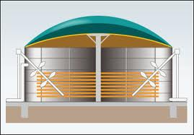
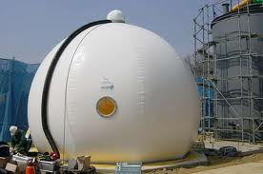
BIOGAS
Rudy Kristian Xavier Miguel Vincent
BRIEF DESCRIPTION ESTIMATION OF BIOGAS PLANT
Digester
The digester is a concrete or steel tank which inside the
chemical reaction that produce biogas
Mixer
Mixer homogenize the digester substrate and allowing
a continued anaerobic digestion
Heating unit
Network of pipes placed inside the digester that permits to fix a constant temperature in order to maintain bacteria living conditions
Gasholder
Gas holder is design to store the biogas produced
Energy village Special meeting 31/10/12

Slide 27
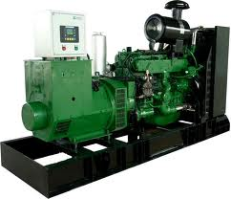
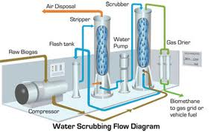
BIOGAS
Rudy Kristian Xavier Miguel Vincent
POSSIBLES USES OF BIOGAS PLANT
Cogeneration (CHP)
  Cogeneration is the combined production of electrical and useful thermal energy from the same primary energy source
  While the power production is generated by a combustion engine, the heat spread is absorbed by recovery unit.
  Efficiency can reach 90%
Upgrading biogas
  Biogas has around 60% of methane
  With appropriate equipment
  biomethane can be obtained having 97% of methane
  This biomethane can be sold like fuel for vehicles
Energy village Special meeting 31/10/12

Slide 28

BIOGAS
Rudy Kristian Xavier Miguel Vincent
ECONOMICAL ESTIMATION OF BIOGAS PLANT AND POSSIBLE CHOICES
Biogas plant
  The whole cost of a biogas plant with this characteristics cost around 1,250,000 €
  Payback of this installation is 10 years
Upgrading biogas
  The suitable equipment cost 400,000 €
  Selling the fuel obtained the benefit is close
  to 380,000 €/year
Energy village Special meeting 31/10/12

Slide 29
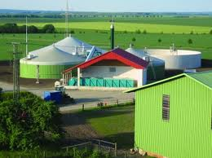
BIOGAS
Rudy Kristian Xavier Miguel Vincent
ECONOMICAL ESTIMATION OF BIOGAS PLANT AND POSSIBLES CHOICES
Cogeneration (CHP)
  In biogas plant there is 2400 m3/day biogas flow
  The gas CHP engine needed cost around 500,000 €
  Selling the electricity production the benefit can reach
  over 200,000 €/year
  The whole heating need in Komossa would be
  covered
  But is needed a district system to distribute
  the heating
  The district heating needed cost bit over 3,000,000 €
Energy village Special meeting 31/10/12

Slide 30


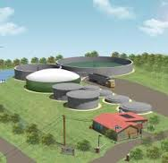
BIOGAS
Rudy Kristian Xavier Miguel Vincent
CONCLUSION
Advantatges
  Uninterrupted production
  Large working live (25 years)
  Low supervision and maintenance
  Contribution to decrease globally warm
  Interesting business to large period of time
  A considerable reduce of electricity and heat bill
  Biofuels technology is growing
Disadvantages
  Initial investment
  Necessary to make a decision about use of biogas
  Depending on decision the investment and the payback can increase significantly
  Possible troubles to peolpe caused for fuel transportation
Energy village Special meeting 31/10/12

Slide 31
Biomass energy
Rudy Kristian Xavier Miguel Vincent
Energy village Special meeting 31/10/12
Definitions:
  Biomass (ecology): The amount of living matter in a given habitat, expressed either as the weight of organisms per unit area or as the volume of organisms per unit volume of habitat.
  Biomass energy: Organic matter, especially plant matter, that can be converted to fuel and is therefore regarded as a potential energy source.

Slide 32
Biomass energy in general
Rudy Kristian Xavier Miguel Vincent
Biomass can be used directly (direct combustion), or converted to different types of fuels: bio fuels, biogas.
In EU 2% of total energy production from biomass
In Finland 20% of total energy production from biomass
Wood is the main source of biomass energy used today
Energy village Special meeting 31/10/12

Slide 33
Categories of biomass materials
Rudy Kristian Xavier Miguel Vincent
Five basic categories of material:
  Wood
  Energy crops
  Agricultural residues
  Food waste
  Industrial waste
Energy village Special meeting 31/10/12

Slide 34
Potential biomass sources in Komossa
Rudy Kristian Xavier Miguel Vincent
Wood
  Firewood, wood pellets, wood chips
Energy crops
  Phalaris arundinacea (reed canarygrass / rörflen)
  Industrial hemp (industrihampa)
  Willow (salix / vide)
Agricultural residues
  Straw from grain production
Energy village Special meeting 31/10/12

Slide 35
Energy potential in Komossa
Rudy Kristian Xavier Miguel Vincent
Type | Growth / year | Area | Energy | Theoretical potential / area / year | Total / year
Wood | 5,6 m³/ha | 300 ha | 2,1 MWh/m³ | 11,8 MWh/ha | 3500 MWh
Rörflen | 4 - 5 ton/ha | 400 ha | 4 MWh/ton | 16 - 20 MWh/ha | 6400 - 8000 MWh
Industrial Hemp | 6 - 10 ton/ha | 400 ha | 4,8 MWh/ton | 30 - 50 MWh/ha | 12 000 - 20 000 MWh
Salix | 7 - 10 ton/ha | 400 ha | 5,0 MWh/ton | 35 - 50 MWh/ha | 14 000 - 20 000 MWh
Straw | 3 - 4 ton/ha | 400 ha | 4,8 MWh/ton | 14 - 19 MWh/ha | 5 600 - 7600 MWh
Skogscentralen Vasa, Vörå kommun, www.motiva.fi, energiahamppu.turkuamk.fi, www.bioenergiportalen.se
Energy village Special meeting 31/10/12

Slide 36
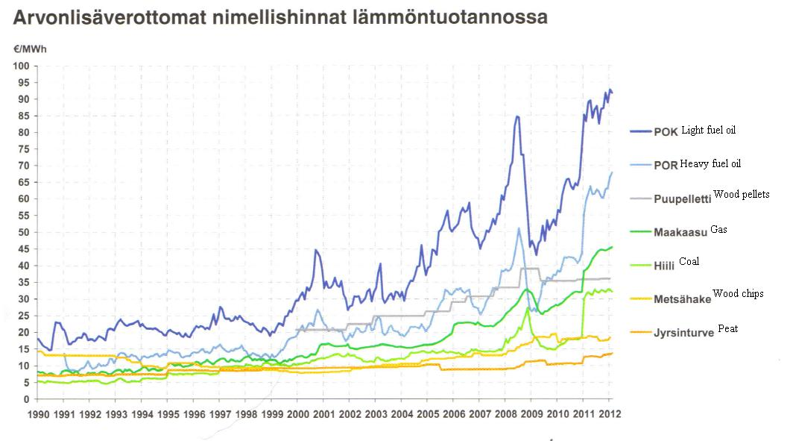
General fuel prices
Rudy Kristian Xavier Miguel Vincent
BioEnergia lehti nr 2. 2012
Energy village Special meeting 31/10/12

Slide 37
General fuel prices
Rudy Kristian Xavier Miguel Vincent
Wood pellets: 36 €/MWh
Wood chips: 18 €/MWh
Rörflen: Production cost: 22 -25 €/MWh
Salix: 18 – 21€/MWh
Fuel oil: 1,10 €/l ≈ 110 €/MWh
Electricity: 12 c/kWh ≈ 120 €/MWh
Energy village Special meeting 31/10/12

Slide 38
Economical comparison of the different solutions
Rudy Kristian Xavier Miguel Vincent
Example: Building new 150 m² house:
  Energy needed for heating + hot water:
    20 000kWh/year
  Floor heating
  Options: Electrical heating, fuel oil, wood pellet, firewood
  Economic lifetime 10
  Interest 4%
Energy village Special meeting 31/10/12

Slide 39
Economical comparison of the different solutions
Rudy Kristian Xavier Miguel Vincent
/ year
katterno.fi, motiva.fi
Energy village Special meeting 31/10/12

Slide 40
Pros and cons of the different fuels
Rudy Kristian Xavier Miguel Vincent
Category: Wood
        + Low price of wood fuel
        + Existing technology and experience
        + Available
Category: Energy crops
        + Large energy potential
        - Higher price than wood fuel
        - Farmland needed
        - New technology needed to use the fuel in most cases
Category: Agricultural residues
        + Residue from existing crops
        - Dedicated burning systems needed
        - Harvesting dry straw can be difficult
Energy village Special meeting 31/10/12

Slide 41
Conclusions
Rudy Kristian Xavier Miguel Vincent
Wood category fuels, a good option for Komossa
  Already in use, existing systems and experience
  Relatively low prices
  Room to develop and use more
Energy crops and straw
  Large energy potential
  Price of fuel
  No existing systems for using the fuel
  High investment cost in new systems
Energy village Special meeting 31/10/12

Slide 42
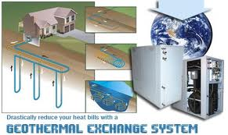
Rudy Kristian Xavier Miguel Vincent
Energy village Special meeting 31/10/12

Slide 43
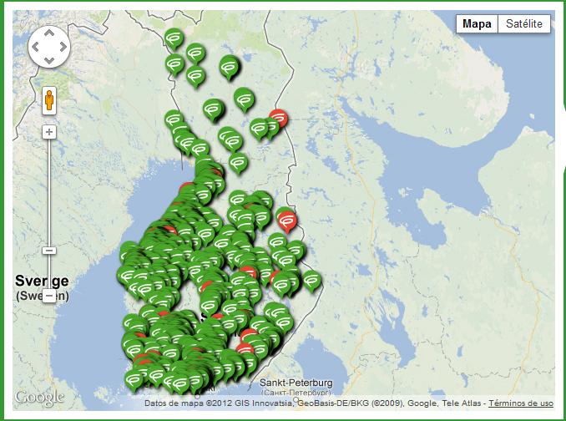
Geothermal
Rudy Kristian Xavier Miguel Vincent
Geothermal Energy in Finland
Geothermal energy use the heat of the underground to heat fluids.
Each year in Finland in most households consider geothermal energy. Thanks to its simplicity of installation and maintenance.
Energy village Special meeting 31/10/12

Slide 44
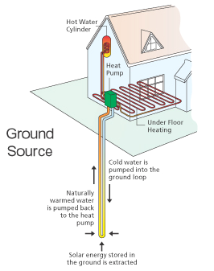
Rudy Kristian Xavier Miguel Vincent
Geothermal
Operating Scheme
Components
Heat pump: Is responsible for pumping the water from the underground into the home, has a system of evaporation and condensation to achieve higher temperature in the fluid.
Drill: Is a drill that is done at 5 or 6 meters of the house, at a depth between 150 and 230 m and a diameter of about 15mm. Inside of the drill there is a tube through which the fluid circulates.
Pipes: Are the tubes that carrying the fluid to the heat pump to underground , and the heat pump to inside the home.
Energy village Special meeting 31/10/12

Slide 45
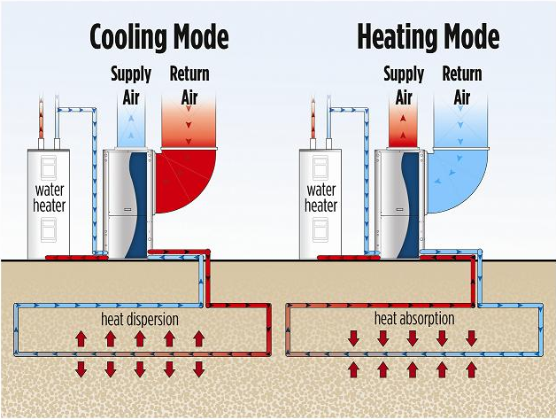
Geothermal
Rudy Kristian Xavier Miguel Vincent
Brief explanation of how geothermal energy works
A practical case
A house with 100-150 m² requires a heat pump with 5.0 kW.
To collect the necessary heat from under the soil, some 200 metres of pipe need.
Heat pump systems can meet 60 % of the energy needs of a detached house and 90% of heating needs. The rest of the heat needed can be obtained from other energy
Operation reversible mode
Energy village Special meeting 31/10/12

Slide 46
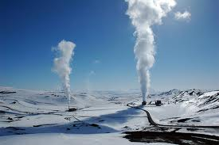
Geothermal
Rudy Kristian Xavier Miguel Vincent
Investment estimation
Advantages
Short period of installation and payback
Very low maintenance
Disadvantages
Depending on type of land, the investment increase
Need another system to cover energy needs
Element | Cost per unit | Units | Total price
Heat Pump | 6500 | 12 kW | 6500
Drill | 35 € · m | 160 – 230 m | 5600 – 8050 €
Pipes | 6,20 € · m | 160 -230 m | 992 – 1426 €
 |  | TOTAL | Max. 15976 €
Energy village Special meeting 31/10/12

Slide 47

Thanks for your attention
We welcome your questions and suggestions

